Slide 1
ORGANISATIONAL
BEHAVIOUR
CHAPTER-11
WORK STRESS

Slide 2
LEARNING OBJECTIVES
Stress is one’s reaction to stressors and consequence of such reaction.
Impact of stress varies from person to person.
Stress originates at the individual, group, organisational or extra-organisational level.
Outcomes of stress include physical and physiological problems of employees, increased absenteeism and reduced productivity for organisations.
Burnout is the consequence of prolonged exposure to stress.
There are individual and organisational strategies to cope with stress.
Stress is negatively related to performance.

Slide 3
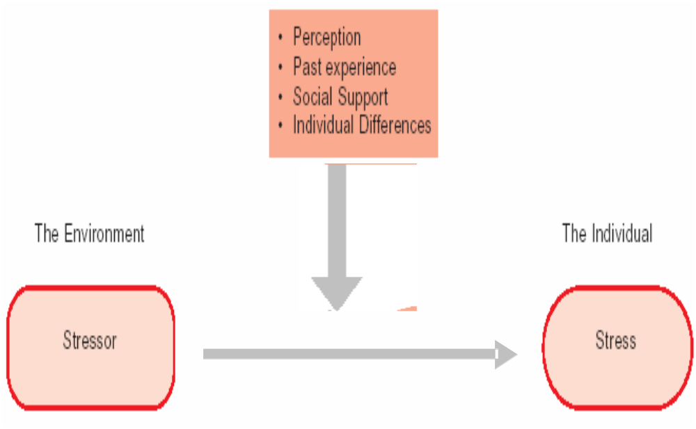
Relationship Between Stressors and Stress

Slide 4
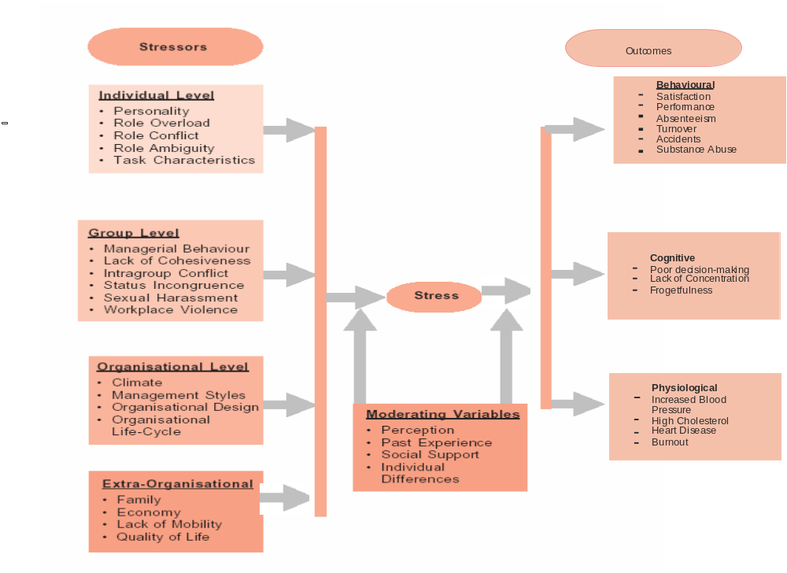
A Model of Occupational Stress

Slide 5
Type A Personality
Always moves, walks and eats rapidly.
Feels impatient with the pace of things, hurries others, dislikes waiting.
Does several things simultaneously.
Feels guilty when relaxing.
Tries to schedule more and more in less and less time.
Uses nervous gestures such as clenched fist, banging the hand on the table.
Does not have time to enjoy life.

Slide 6
Type B Personality
Is not concerned about time.
Is patient.
Does not brag
Play to fun, not to win.
Relaxes without feeling guilty.
Has no pressing deadlines.
Is mild-mannered.
Is never in a hurry.5

Slide 7
Attitudinal Characteristics of Burnout
Attitude Description
Fatalism A feeling that you lack control over your work.
Boredom A lack of interest in doing your job.
Discontent A sense of being unhappy with your job.
Cynicism A tendency to undervalue the content of your job and the rewards received.
Inadequacy A feeling of not being able to meet your objectives.
Failure A tendency to discredit your performance and conclude that you are ineffective.
Overwork A feeling of having too much to do and not enough time to complete it.
Nastiness A tendency to be rude or unpleasant to your co-workers.
Dissatisfaction A feeling that you are not being justly rewarded for your efforts.
Escape A desire to give up and get away from it all.

Slide 8
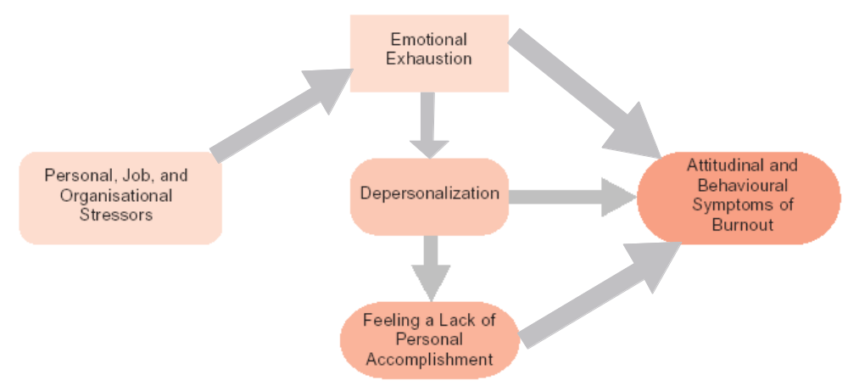
A Model of Burnout

Slide 9
Stress Vs Burnout
Stress Burnout
The person feels fatigued The individual encounters chronic exhaustion.
The person is anxious The individual is hypertensive.
The person is dissatisfied with his or her job The individual is bored and cynical about the work.
The person’s job commitment has dropped off The individual’s job commitment is virtually nil; he or she is mentally detached from the organisation.
The person feels moody The individual feels impatient, irritable and unwilling to
talk to others.
The person feels guilty The individual encounters mental depression.
The person is having difficulty concentrating; The individual does not seem to know where he or she
he or she tends to forget things is; forgetfulness is becoming more and more frequent.
The person undergoes physiological changes The individual begins to voice psychosomatic complaints.
such as increased blood pressure and heart beat

Slide 10
Signs of Stress
Physical Emotional Mental Relational Spiritual Behavioural
Signs Signs Signs Signs Signs Signs
Appetite Bad temper Lacking Isolation A feeling of Pacing
changes humour emptiness
Headaches Anxiety Dull senses Defensive Apathy Swearing
Fatigue Nightmares Lethargy Intolerance Inability to Substance forgive abuse
Insomnia Irritability Boredom Resentment Cynicism Nail biting
Indigestion Depression Indecisiveness Loneliness Loss of direction Slumped posture
Colds Frustration Forgetfulness Nagging Doubt Restlessness
Weight change Oversensitivity Poor Lower sex drive Need to prove Risk aversion concentration self
Teeth grinding Mood swings Personality Aggression Negative Eating changes outlook disorders
Tension Fearfulness Stuck in past Abuse Gloom Headaches

Slide 11
Strategies to Eliminate Stress
        Improvements in the physical work environment;
        Job redesign to eliminate stressors;
        Changes in workloads and deadlines;
        Structural reorganization;
        Changes in work schedules, more flexible hours and sabbaticals;
        Management by objectives or other goal-setting programmes;
        Greater levels of employee participation, particularly in planning changes that affect them; and
        Workshops dealing with role clarity and role analysis.

Slide 12
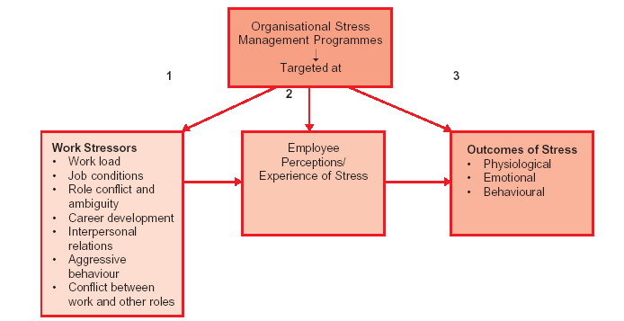
Targets of Organisational Stress Management Programmes

Slide 13
Summary
        Stress is one’s response to a disturbing factor in the environment and the consequences of such reaction.
        Response to stress varies between individuals. How an individual experiences stress depends on perception, past experience and social support the individual has.
        Stressors originate at the individual, group, organisational or extra-organisational level.
        Outcomes of stress are very serious. Individual suffers from stress, so also the organisation which has to pay in terms of absenteeism, reduced productivity and claims of damages from affected employees.
        One serious consequence of stress is burnout. Burnout results from prolonged exposure to stress.
        There are individual as well as organisational strategies to cope with stress.
        Stress is negatively related to performance. Higher the stress, lower the performance. The earlier belief that moderate level of stress enhances performance is not held tenable now.

Slide 14
Key Terms
Work Stress
Burnout
Meditation
Employee Assistance Programmes
Stressors
Social support
Time management
Wellness Programmes

